Slide 1
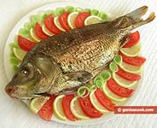
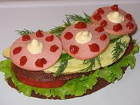
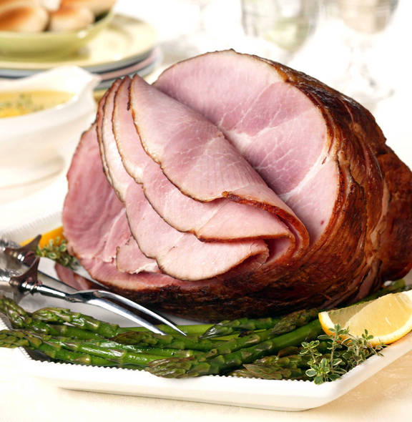
I would like to be healthy

Slide 2
Wish Sentences
Сожаления и пожелания выражаются в английском языке с помощью глагола to wish (хотеть, желать) и придаточного изъяснительного предложения (object clause).
I wish I knew her phone number. — Как жаль, что я не знаю номер ее телефона.
I wish I had met you earlier. — Как жаль, что я раньше тебя не встретил.
В условном предложении при выражении сожаления или пожелания, глагол to be всегда употребляется в форме were, вне зависимости от лица и числа подлежащего, к которому он относится.
I wish he were here now. — Жаль что его нет сейчас здесь.
I wish the house were not so expensive. — Как жаль, что дом такой дорогой.

Slide 3
Complete these sentences with the correct form of the verb. Some sentences require a negative.
Bruce wishes he……… (have) more money so he could buy a new sweater.
I wish it………... (snow) now that it’s Christmas.
I wish I………(be) taller so that I could be in the basketball team.
I wish you………(stop) watching television while I am talking to you.
I wish you………… (do) that. It annoys me.
I wish the holidays……….. (come) so we could go off to the seaside.
I wish they………. (build) that block of flats right in front of our window.
Of course Tom wishes he………. (come) with us in Paris, but he has to stay here and work.
I wish we………(go) to the match on Saturday but we’re visiting my uncle instead.

Slide 4
The keys
Bruce wishes he had more money so he could buy a new sweater.
I wish it were snowing now that it’s Christmas.
I wish I were taller so that I could be in the basketball team.
I wish you would stop watching television while I am talking to you.
I wish you wouldn't do that. It annoys me.
I wish the holidays would come so we could go off to the seaside.
I wish they wouldn't build that block of flats right in front of our window.
Of course Tom wishes he could come with us in Paris, but he has to stay here and work.
I wish we would go to the match on Saturday but we’re visiting my uncle instead.

Slide 5
Prefixes
Re- (again)-снова
Super-( big, more)- супер
Multi- (many)- много
Over- (Too much)- слишком много
Under- (too little)- слишком мало
Semi-(half)- половина
Pre- (before)- перед, до
Co- (together)- вместе

